Slide 1
Packet Analysis
Chapter 4

Slide 2
Protocol Analysis
Where to get information on protocols
IETF Request for Comments (RFC)
Other standards bodies
Institute of Electrical and Electronics Engineers Standards Association (IEEE-SA)
International Organization for standardization (ISO)
Vendors
Researchers

Slide 3
Protocol Analysis (con’t)
Protocol analysis tools
Packet Details Markup Language (PDML) and Packet Summary Markup Language (PSML)
Wireshark
Packet list
Packet details
Packet bytes

Slide 4
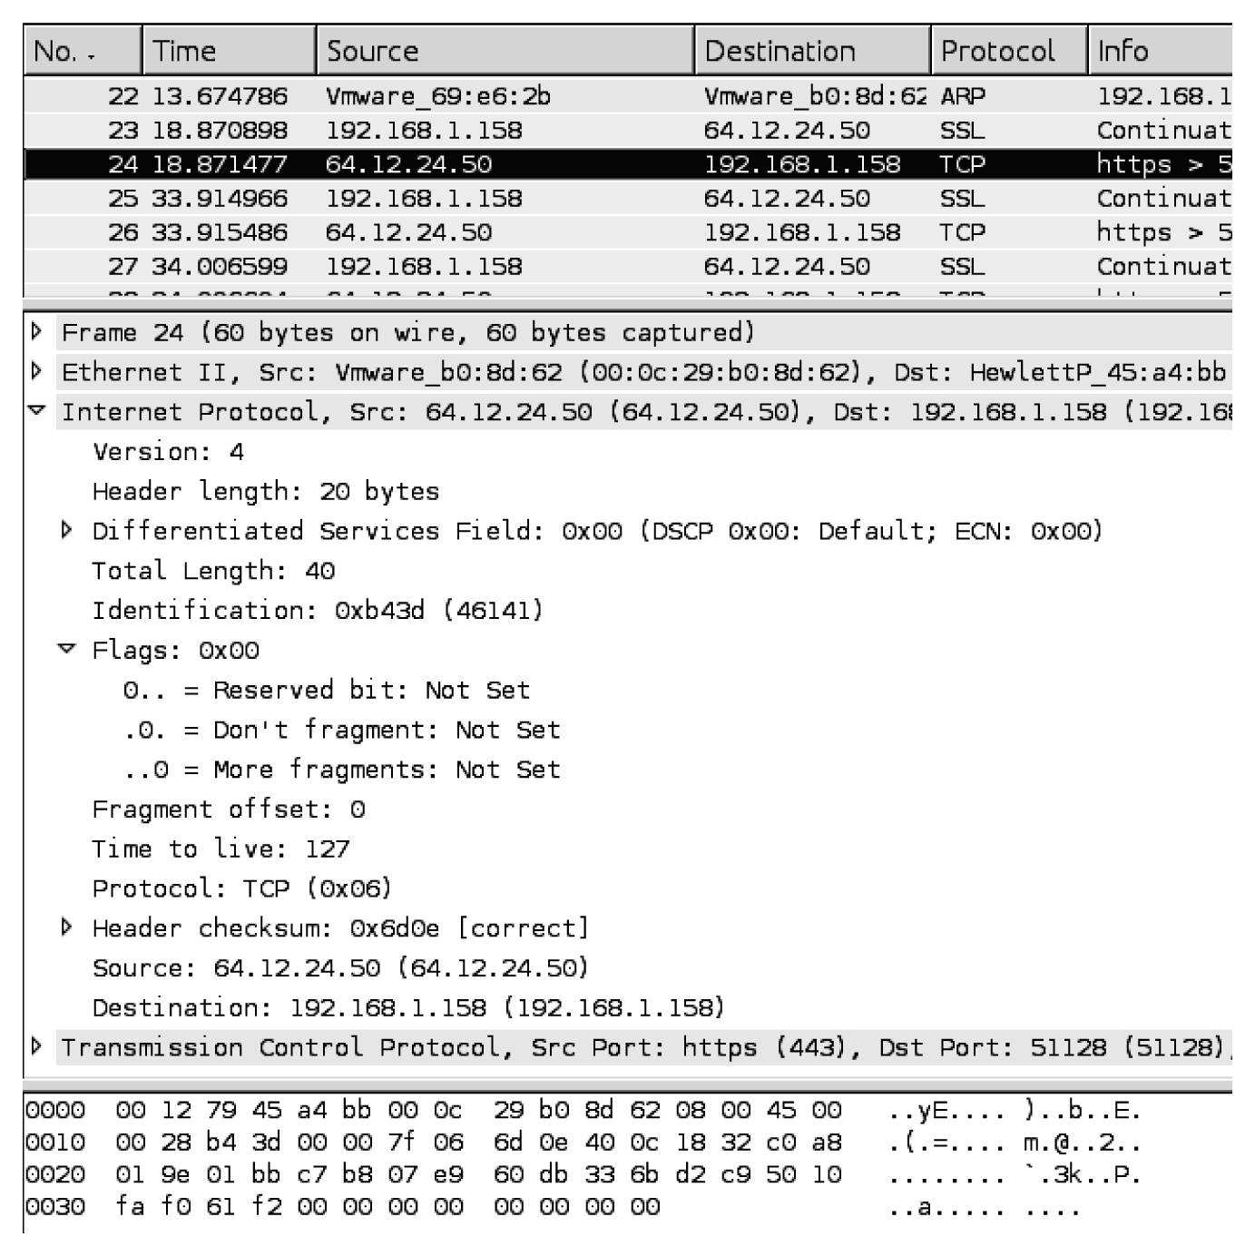
From Network Forensics, by Sherri Davidoff and Jonathan Ham (ISBN: 978-0-13-256471-7) Copyright © 2012 Pearson Education, Inc. All rights reserved.
Figure 4.1 Screenshot of the main Wireshark panels. The top panel is “Packet List,” the middle panel is “Packet Details,” and the bottom panel is “Packet Bytes.”

Slide 5
Protocol Analysis (con’t)
Tshark
Basic usage for reading from a capture file:
Tshark –r capturefile.pcap
Disable network object name resolution using the –n flag
Tshark –n –r capturefile.pcap
Select an output format using the T flag
Tshark –n –r capturefile.pcap –T pdml
Print a specific field, with T and e flags
Tshark –r capturefile.pcap –T fields –e frame.number –e ip.addr –e udp
Use the –d flag to implement Wireshark’s “Decode As” functionality. For example, if you want tshark to treat all traffic in a capture on TCP port 29008 as HTTP traffic, then you would use the following:
Tshark –r capturefile.pcap –d tcp.port==29008,http
Also able to use display filters and BPF-filters:
Tshark –r capturefile.pcap –R ‘ip.addr == 192.168.1.1’ (display filter example)
Tshark –r capturefile.pcap ‘host 192.168.1.1’ (BPF filter example)

Slide 6
Scenario: Ann’s Bad AIM
Found on p83 in book
What is the name of Ann’s IM buddy?
What was the first comment in the captured IM conversation?
What is the name of the file Ann transferred?
What is the magic number of the file you want to extract (first four bytes)?
What was the MD5sum of the file?
What is the secret recipe?
Notes:
These are the questions that we want to be able to answer.

Slide 7
Protocol Analysis Techniques
Protocol identification
Search for common binary/hex/ASCII values that are typically associated with a specific protocol (p84)
Leverage information in the encapsulating protocol (p84)
Leverage the TCP/UDP, many of which are associated with standard default services (p84)
Analyze the function of the source or destination server (specified by IP address or hostname) (p86)
Test for the presence of recognizable protocol structures (p89)

Slide 8
Search for common binary/hex/ASCII values
Sequence that marks the beginning of an IPv4 packet = 0x4500
Tcpdump can be used to view information in the capture.pcap file
Tcpdump –nn –AX –r evidence_file.pcap (p84)

Slide 9
Protocol Analysis Techniques
Protocol decoding
Leverage publicly available automated decoders and tools
Refer to publicly available documentation and manually decode the traffic
Write your own decoder
Wireshark provides a built-in decoder, on the Analyze menu

Slide 10
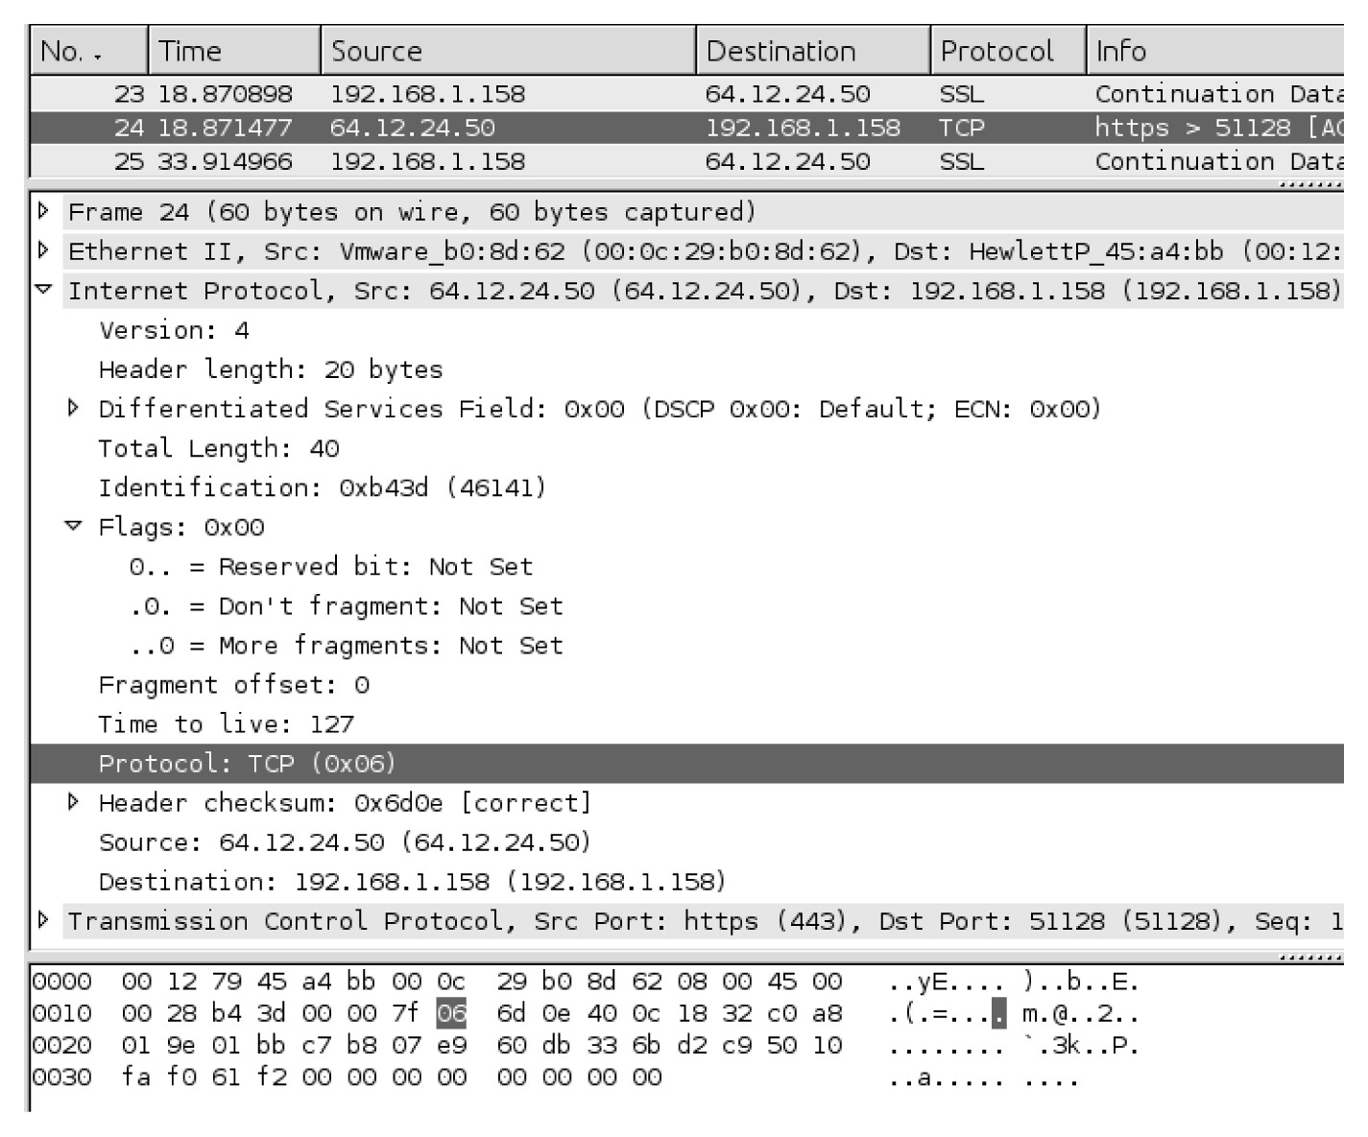
From Network Forensics, by Sherri Davidoff and Jonathan Ham (ISBN: 978-0-13-256471-7) Copyright © 2012 Pearson Education, Inc. All rights reserved.
Figure 4.2 IP protocol details displayed within Wireshark. Notice that the IP packet contains information about the encapsulated protocol (in this case, 0x06, or TCP).

Slide 11
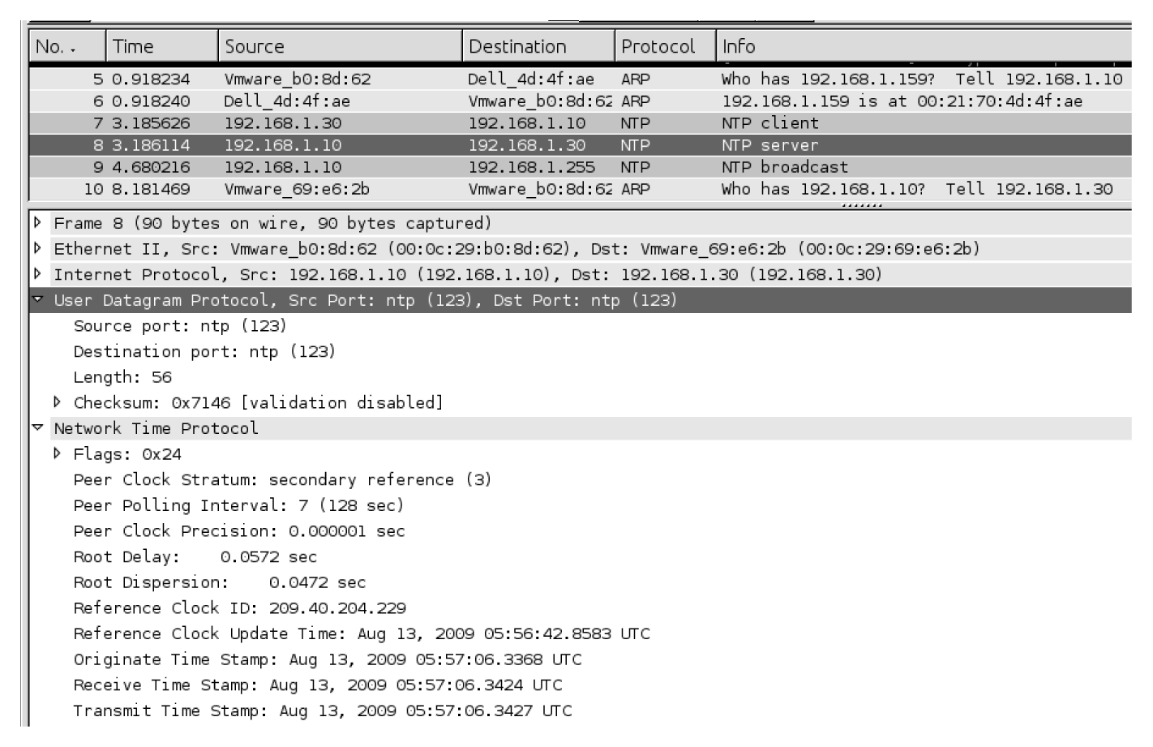
From Network Forensics, by Sherri Davidoff and Jonathan Ham (ISBN: 978-0-13-256471-7) Copyright © 2012 Pearson Education, Inc. All rights reserved.
Figure 4.3 UDP Protocol Details displayed within Wireshark. Notice that Wireshark automatically associates the UDP port, 123, with its IANA-assigned default service, NTP.

Slide 12
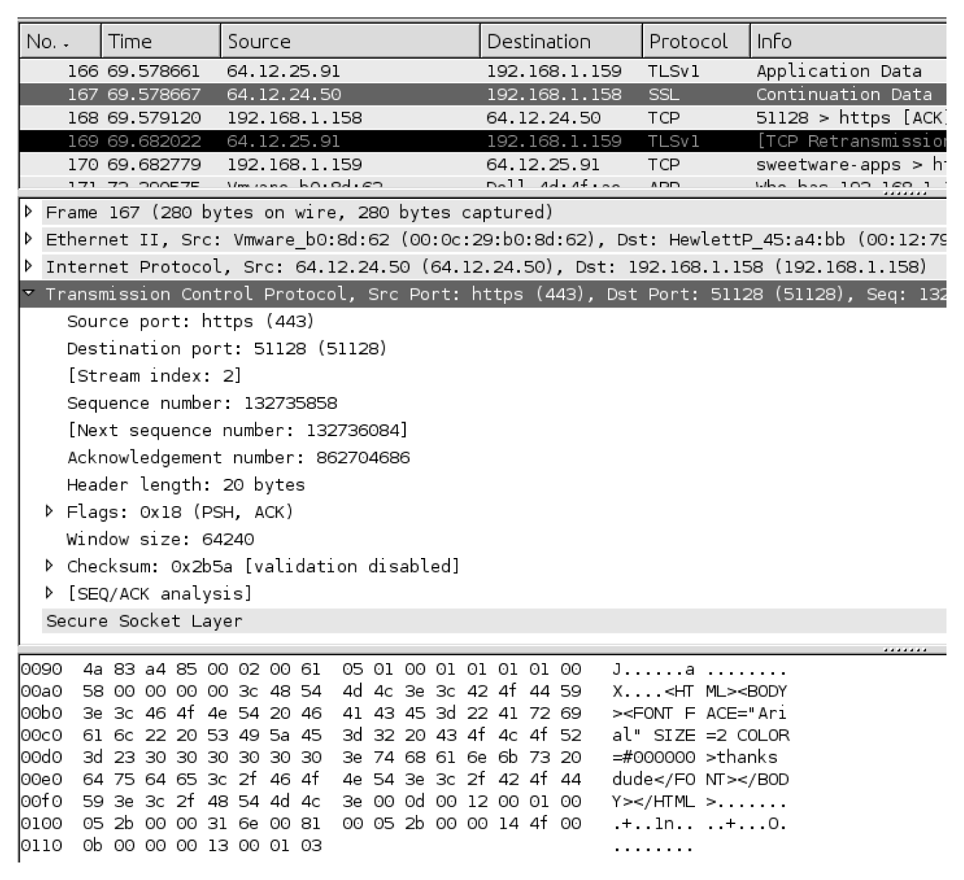
From Network Forensics, by Sherri Davidoff and Jonathan Ham (ISBN: 978-0-13-256471-7) Copyright © 2012 Pearson Education, Inc. All rights reserved.
Figure 4.4 TCP packet details displayed within Wireshark. Notice that Wireshark automatically associates TCP port 443 with its IANA-assigned default service, HTTPS. However, this interpretation is INCORRECT (as evidenced by the fact that the packet contents are not encrypted, and no protocol details are displayed under the heading “Secure Socket Layer”).

Slide 13
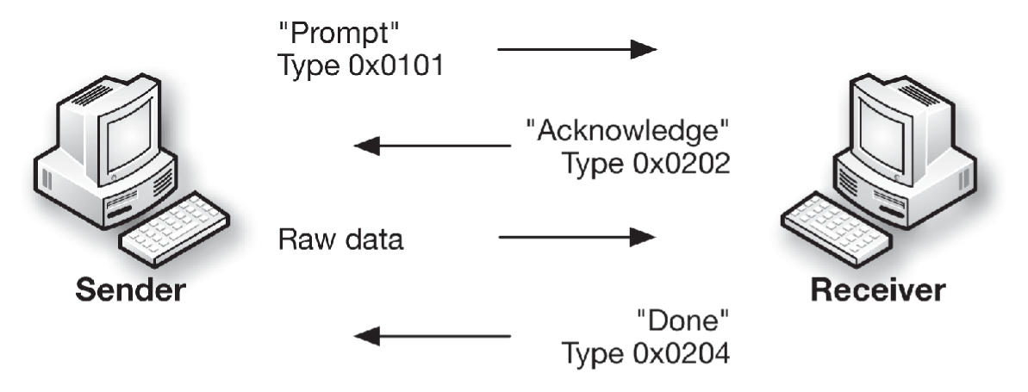
From Network Forensics, by Sherri Davidoff and Jonathan Ham (ISBN: 978-0-13-256471-7) Copyright © 2012 Pearson Education, Inc. All rights reserved.
Figure 4.5 Illustration of the OFT protocol used to transfer files through AIM.

Slide 14
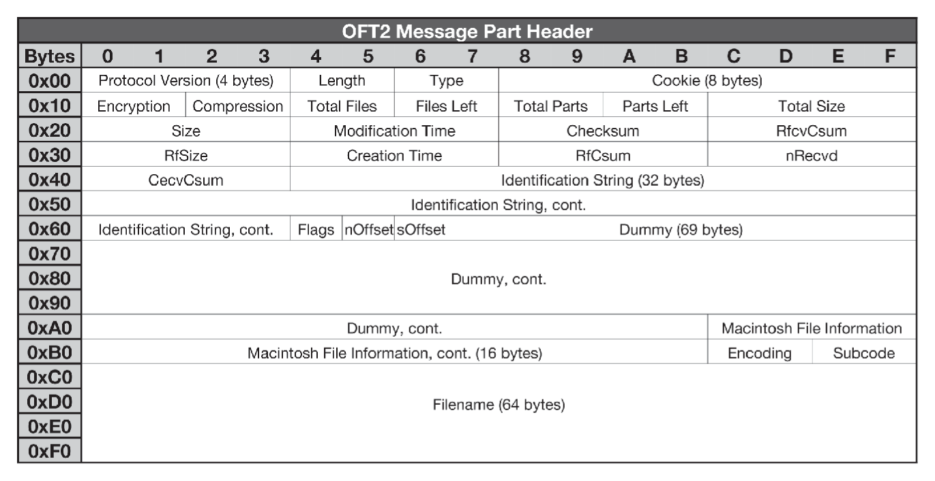
From Network Forensics, by Sherri Davidoff and Jonathan Ham (ISBN: 978-0-13-256471-7) Copyright © 2012 Pearson Education, Inc. All rights reserved.
Figure 4.6 Illustration of the OFT2 header structure.

Slide 15
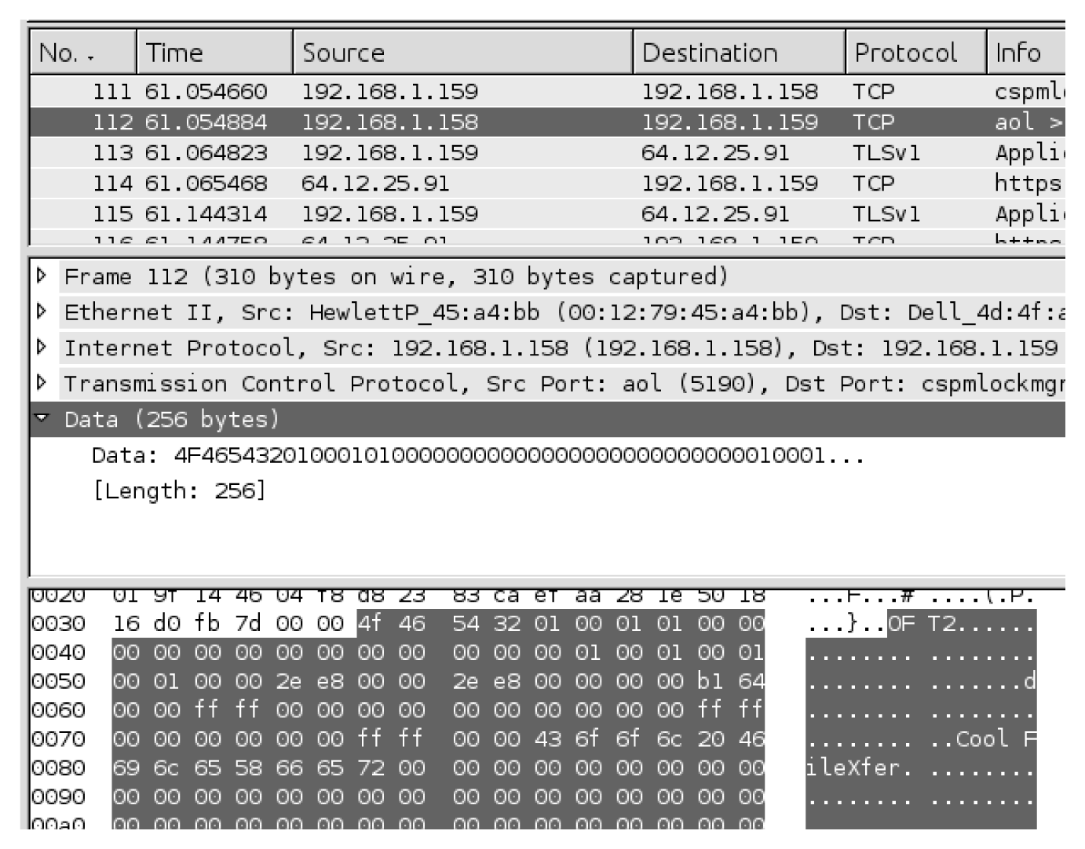
From Network Forensics, by Sherri Davidoff and Jonathan Ham (ISBN: 978-0-13-256471-7) Copyright © 2012 Pearson Education, Inc. All rights reserved.
Figure 4.7 Frame #112 from “Ann’s Bad AIM.” Notice that Wireshark does not automatically identify a protocol higher than Layer 4 (TCP). However, analysis of the TCP payload shown in the Packet Bytes window reveals structures that correlate with the OSCAR File Transfer protocol.

Slide 16
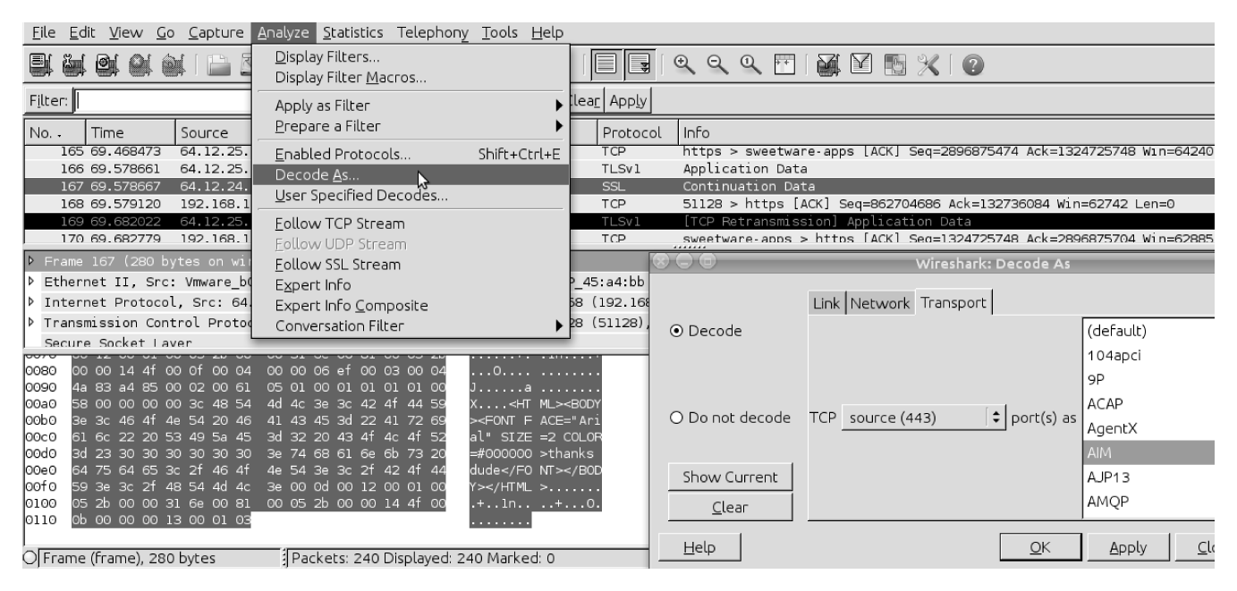
From Network Forensics, by Sherri Davidoff and Jonathan Ham (ISBN: 978-0-13-256471-7) Copyright © 2012 Pearson Education, Inc. All rights reserved.
Figure 4.8 Frame #167 from “Ann’s Bad AIM.” Wireshark incorrectly decoded this packet as “Secure Socket Layer. ”This screenshot illustrates how to use Wireshark’s “Decode As” function to interpret the data as AIM traffic instead.

Slide 17
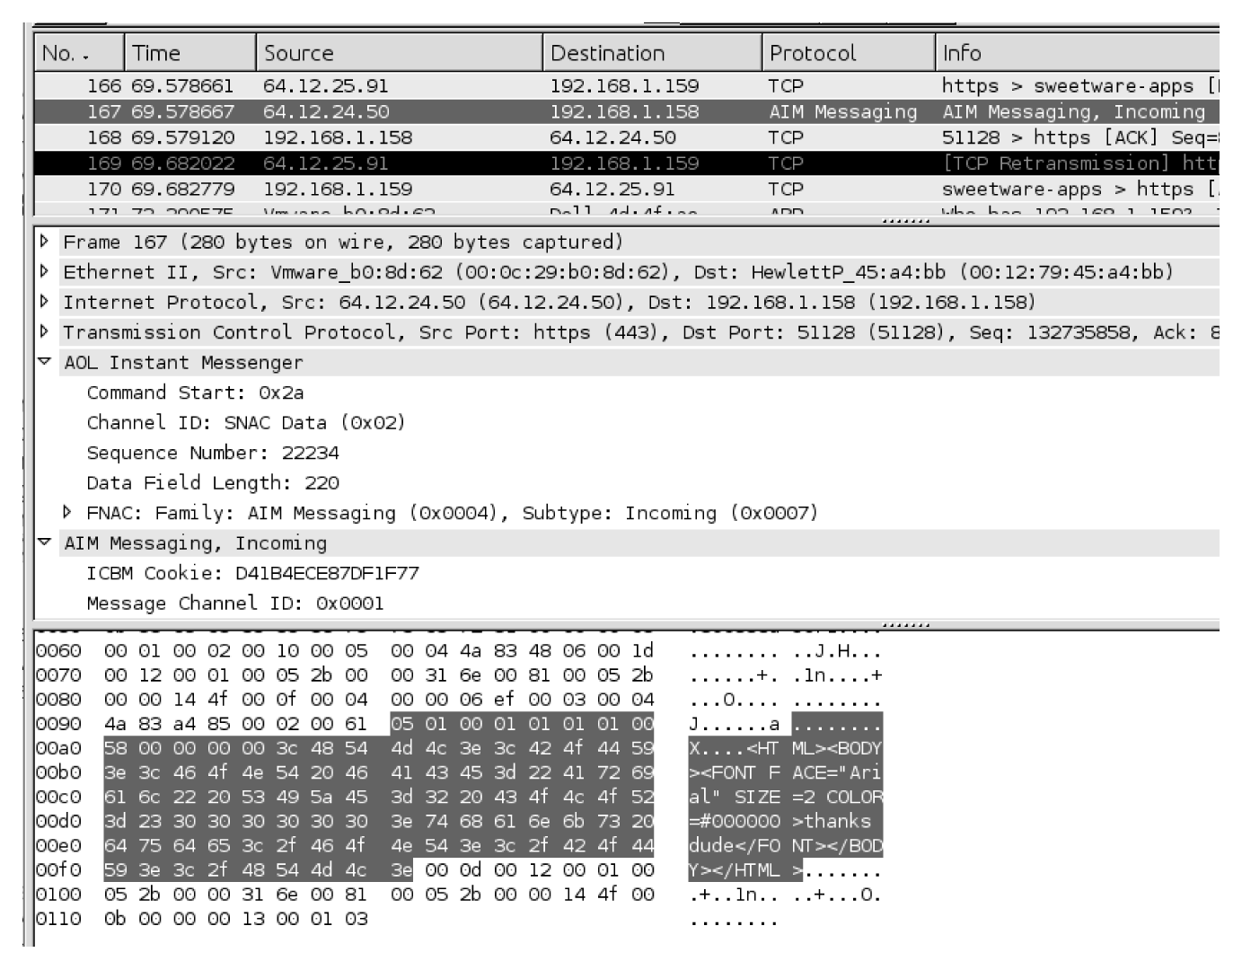
From Network Forensics, by Sherri Davidoff and Jonathan Ham (ISBN: 978-0-13-256471-7) Copyright © 2012 Pearson Education, Inc. All rights reserved.
Figure 4.9 In this screenshot, Frame 167 has been decoded as AIM traffic. Notice that extensive details regarding the AIM protocol are now visible, indicating that our selection of AIM as the protocol was probably correct.

Slide 18
Protocol Analysis Techniques (con’t)
Exporting fields (p92-95)
See Figure 4-10 (next slide)
The command line shown below extracts frame #112

Slide 19
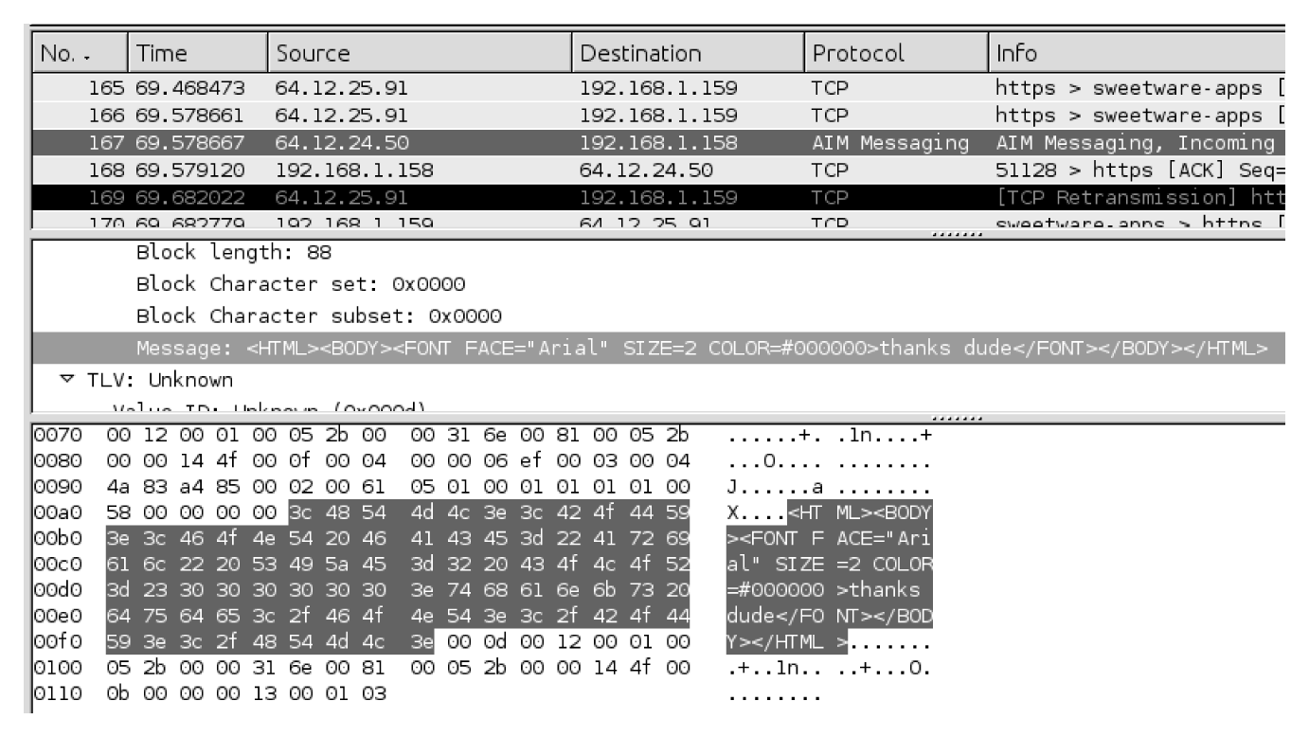
From Network Forensics, by Sherri Davidoff and Jonathan Ham (ISBN: 978-0-13-256471-7) Copyright © 2012 Pearson Education, Inc. All rights reserved.
Figure 4.10 In this screenshot, Frame 167 has been decoded as AIM traffic. Wireshark displays
individual fields such as the Message field, along with corresponding bytes, and allows the user
to save the contents of these fields.

Slide 20
Packet Analysis
Definition: “examination of contents and/or metadata of one or more packets. Packet analysis is typically conducted in order to identify packets of interest and develop a strategy for flow analysis and content reconstruction.”

Slide 21
Packet Analysis (con’t)
Packet Analysis Tools
Wireshark/tshark display filters (see Figure 4-11 on next slide)
Tshark is the command line version of wireshark and display filters can be used with the –R option
Ngrep: allows you to search for strings at the Network layer in the capture file.
Hex editors
Bless hex editor (figure 4-12)

Slide 22
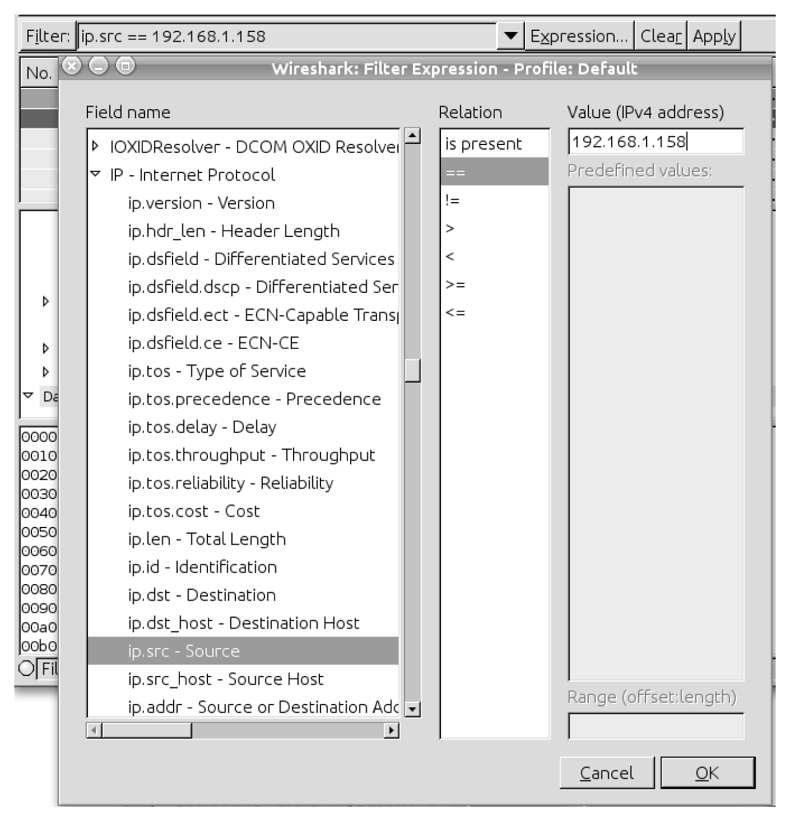
From Network Forensics, by Sherri Davidoff and Jonathan Ham (ISBN: 978-0-13-256471-7) Copyright © 2012 Pearson Education, Inc. All rights reserved.
Figure 4.11 Screenshot of the “Filter Expression” box accessed from the Filter toolbar in Wireshark.

Slide 23
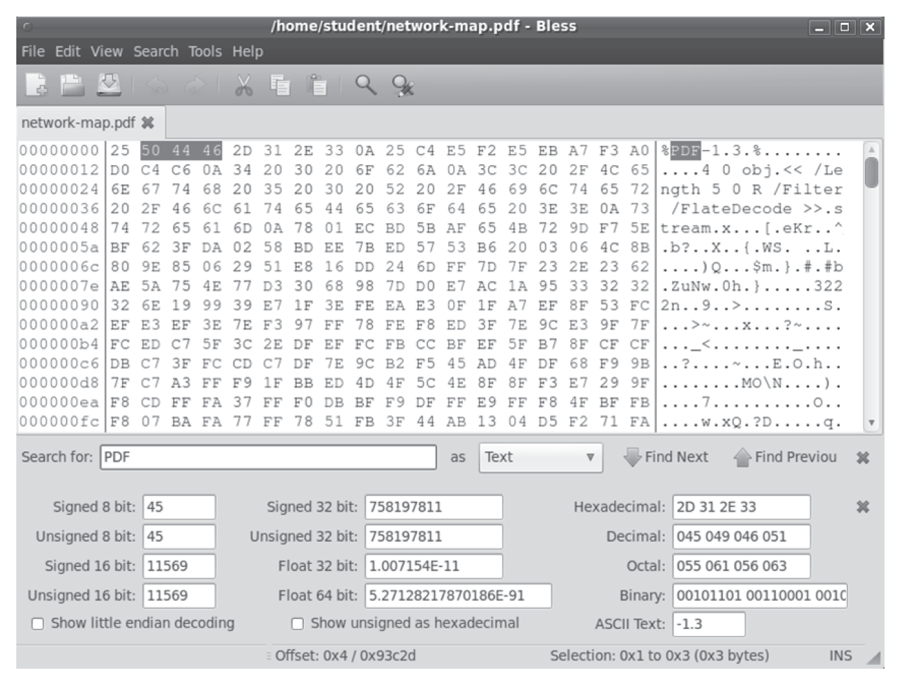
From Network Forensics, by Sherri Davidoff and Jonathan Ham (ISBN: 978-0-13-256471-7) Copyright © 2012 Pearson Education, Inc. All rights reserved.
Figure 4.12 Screenshot of the Bless hex editor.

Slide 24
Packet Analysis (con’t)
Packet Analysis techniques
Pattern matching: identify packets of interest by matching specific values within the packet capture
Parsing protocol fields: extract the contents of protocol fields
Packet filtering: separate packets based on the values of fields in protocol metadata

Slide 25
Packet Analysis (con’t)
Pattern matching:
Use ngrep to search for terms in the capture file.
A “dirty word list” can help us with terms to search on, that may give us information relating to the investigation
Use the following ngrep search:
Ngrep –I evidence.pcap ‘secret|recipe|Ann’

Slide 26
Packet Analysis (con’t)
Parsing Protocol Fields
Use tshark
Command: tshark –r evidence.pcap –d tcp.port==443,aim –T fields –n –e “aim.messageblock.message”
The above pulls out the conversation about the secret recipe

Slide 27
Packet Analysis (con’t)
Packet Filtering
Filtering with BPF: can be done with tcpdump
Tcpdump –s 0 –r evidence.pcap –w evidence-output_file.pcap ‘host 64.12.24.50 and host 192.168.1.158’
The above dumps traffic between the two hosts listed into the output file for us.
Wireshark display filters (figure 4-13)
OFT file transfer: sender’s AIM client listens for specific connections on a specific port and sends a channel 2 ICBM packet to the AOL server. This packet will tell us the port and IP address to which the remote peer should connect in order to receive the file.
Notes:
Display filter: aim_messaging.channelid==0x0002
This filter will pick out the channel 2 ICBM messages (figure 4-14)

Slide 28
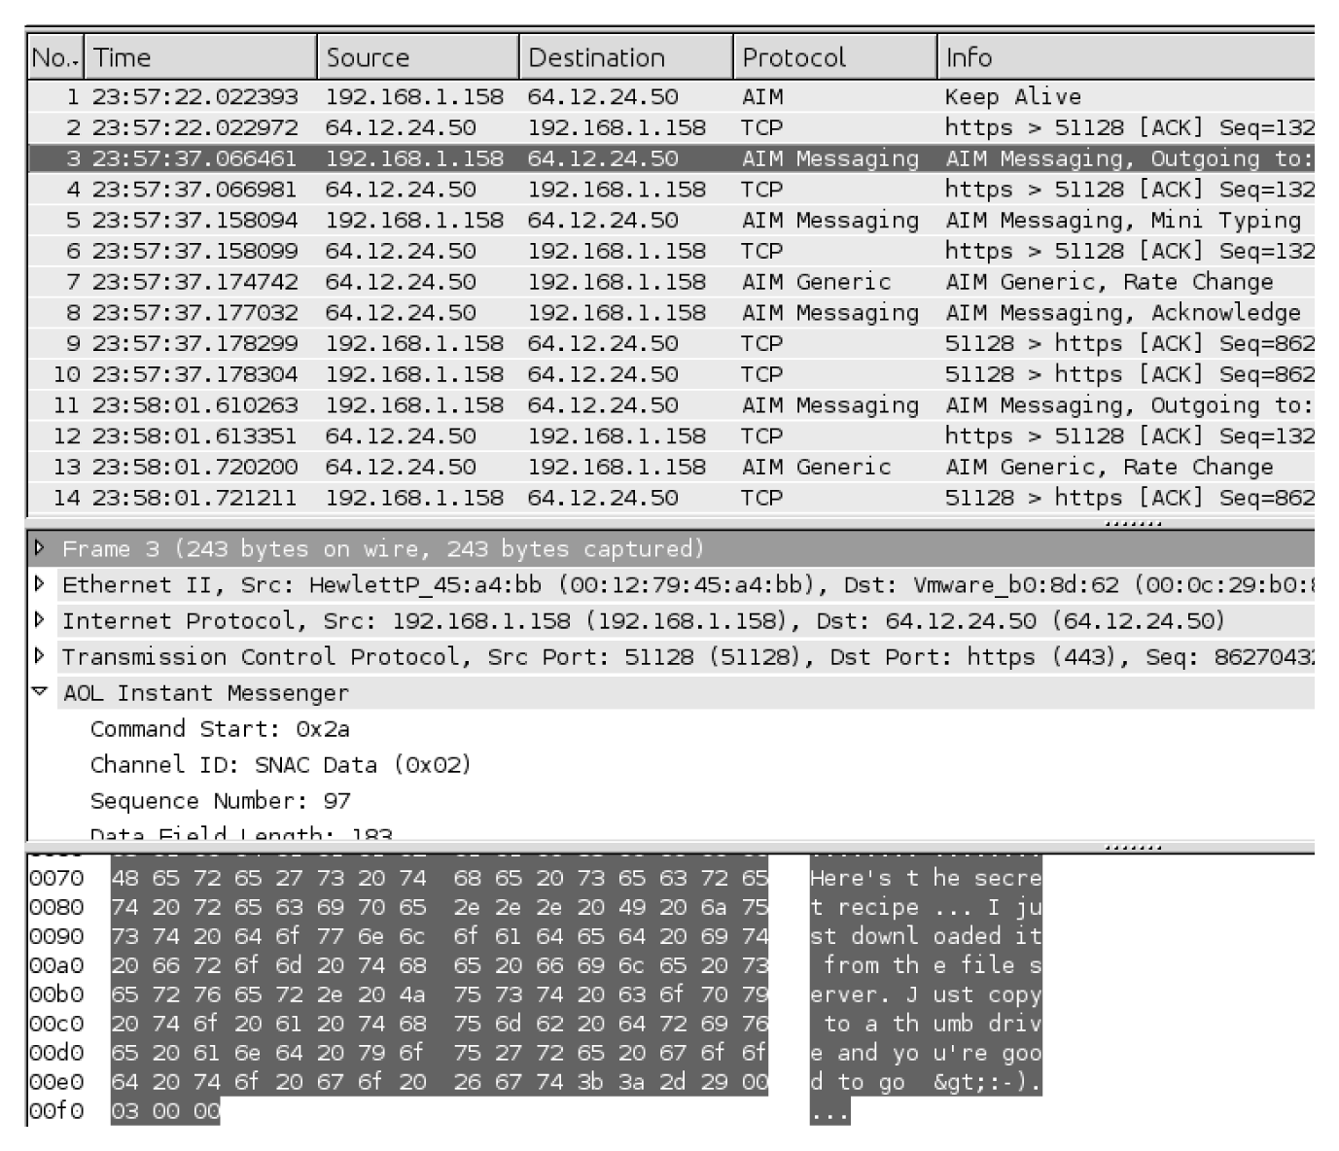
From Network Forensics, by Sherri Davidoff and Jonathan Ham (ISBN: 978-0-13-256471-7) Copyright © 2012 Pearson Education, Inc. All rights reserved.
Figure 4.13 The filtered packet capture, evidence01-talkers.png, opened in Wireshark. The traffic relating to TCP port 443 has been decoded as AIM.

Slide 29
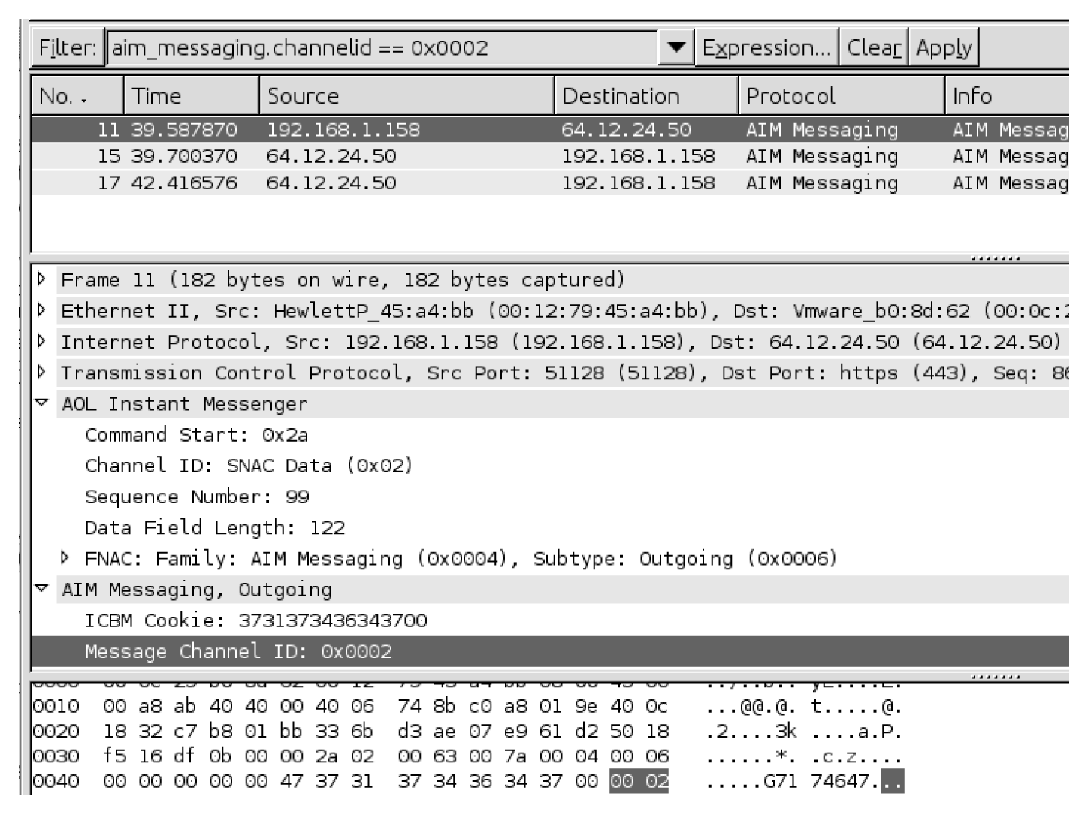
From Network Forensics, by Sherri Davidoff and Jonathan Ham (ISBN: 978-0-13-256471-7) Copyright © 2012 Pearson Education, Inc. All rights reserved.
Figure 4.14 A screenshot of Wireshark with a display filter that selects AIM ICBM channel 2 messages.

Slide 30
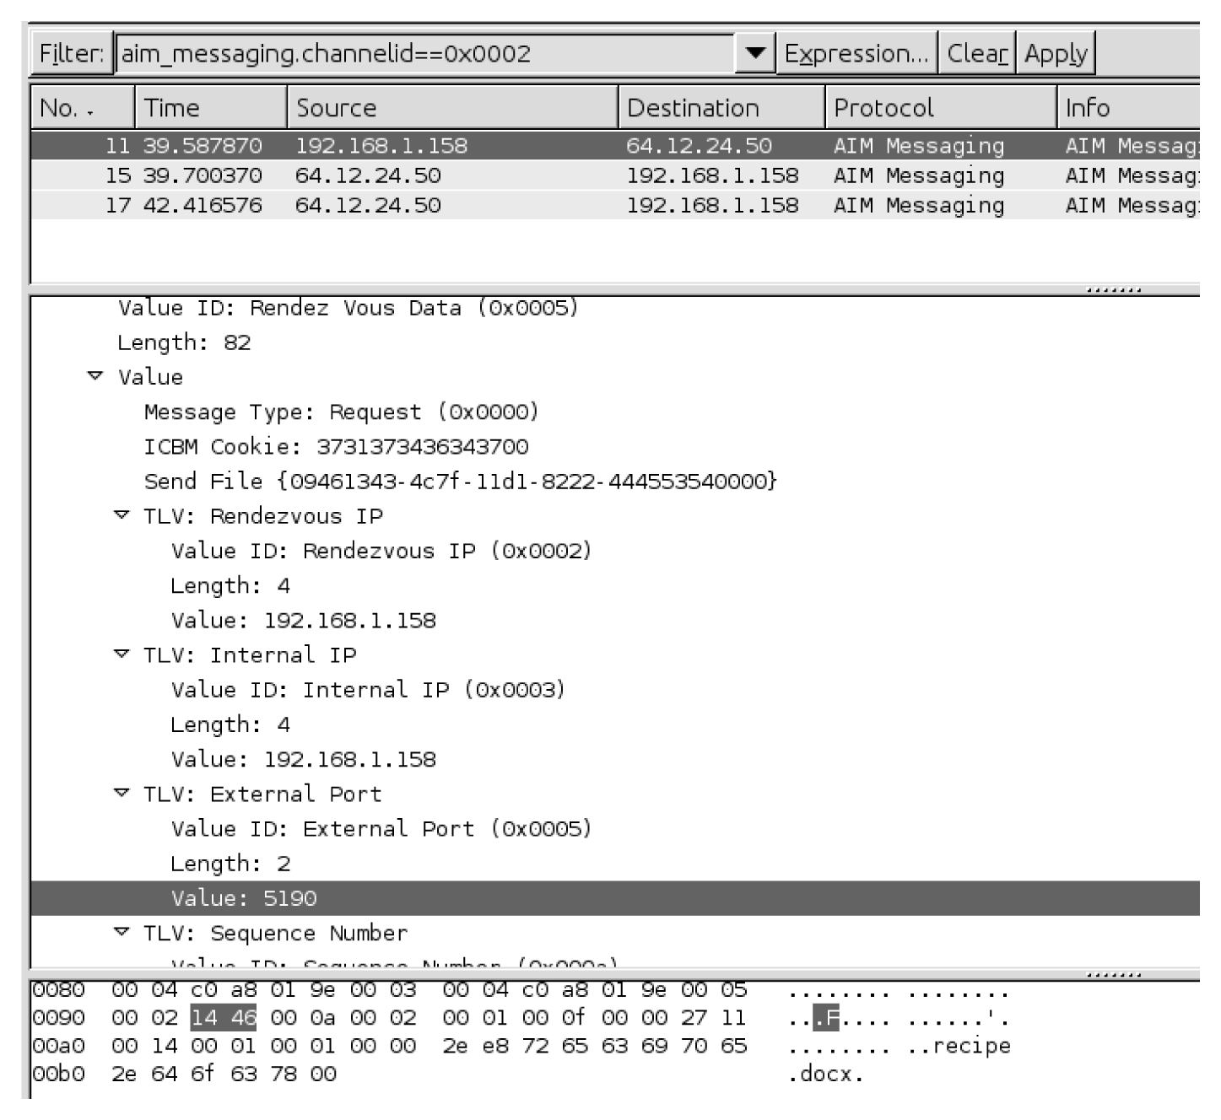
From Network Forensics, by Sherri Davidoff and Jonathan Ham (ISBN: 978-0-13-256471-7) Copyright © 2012 Pearson Education, Inc. All rights reserved.
Figure 4.15 A screenshot of Wireshark displaying the IP address and port offered by the sender for an OFT file transfer.

Slide 31
Flow Analysis
Definition: “examination of sequences of related packets (“flows”). Flow analysis is typcially conducted in order to identify traffic patterns, isolate suspicious activity, analyze higher-layer protocols, or extract data.” (p104, RFC 3679)

Slide 32
Flow Analysis (con’t)
Flow analysis tools
Wireshark: Follow TCP Stream function (figure 4-16, 17)
Conversations in Wireshark/tshark
Tcpflow
Pcapcat
Tcpxtract

Slide 33
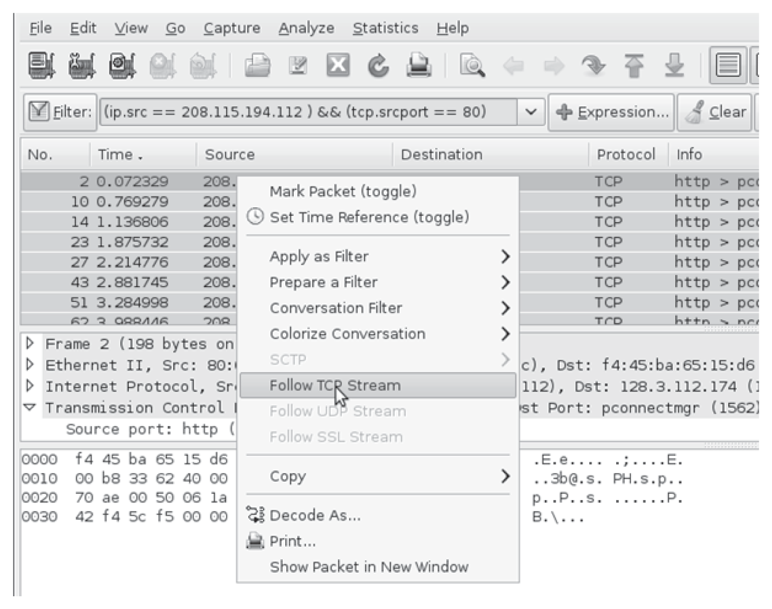
From Network Forensics, by Sherri Davidoff and Jonathan Ham (ISBN: 978-0-13-256471-7) Copyright © 2012 Pearson Education, Inc. All rights reserved.
Figure 4.16 An example of Wireshark’s “Follow TCP Stream” function.

Slide 34
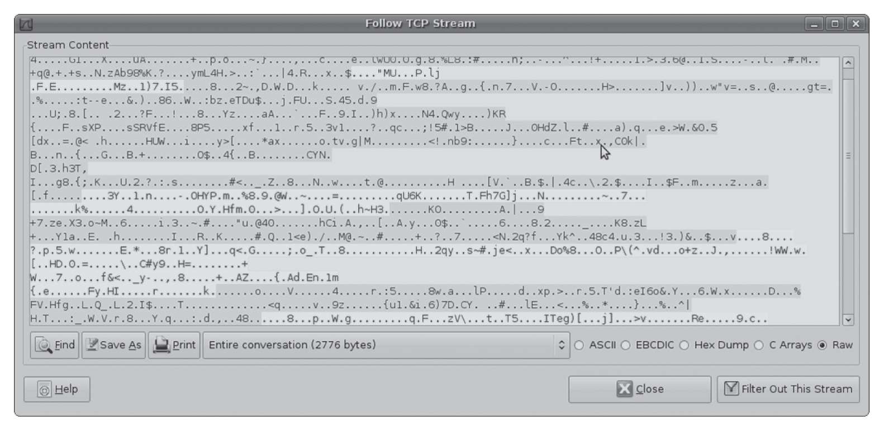
From Network Forensics, by Sherri Davidoff and Jonathan Ham (ISBN: 978-0-13-256471-7) Copyright © 2012 Pearson Education, Inc. All rights reserved.
Figure 4.17 Wireshark’s “Follow TCP Stream” function in action. The dark gray text represents traffic flowing in one direction, whereas the light gray text represents traffic flowing in the opposite direction. (In real life these colors were pink and blue, respectively; the image was modified to print in grayscale.)

Slide 35
Flow Analysis (con’t)
Flow analysis techniques
List conversations and flows: list all conversations and/or flows within a packet capture, or only specific flows based on their characteristics
Export a flow: isolate a flow, or multiple flows, and store the flow(s) of interest to disk for further analysis
File and data carving: extract files or other data of interest from the reassembled flow

Slide 36
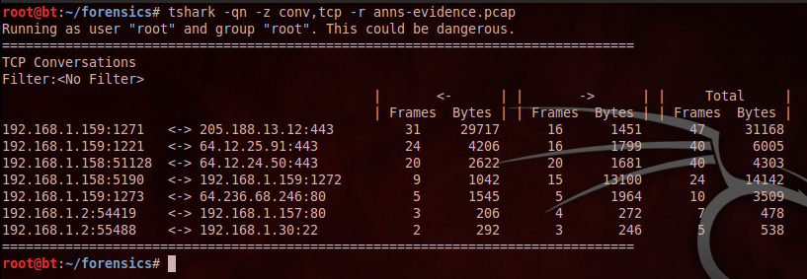
Flow Analysis (con’t)
List conversations
We can see one conversation that involved the port 5190.
Notes:
We know, from previous analysis that port 5190 was used to transfer the file “recipe.docx”. This tshark output confirms that 1,042 bytes were transferred in that conversation.

Slide 37
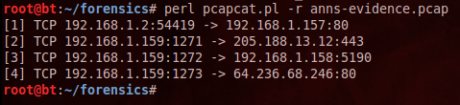
Flow Analysis (con’t)
List TCP Flows
Can be used to corroborate our earlier findings
Pcapcat is used in this instance to confirm the conversation on port 5190

Slide 38
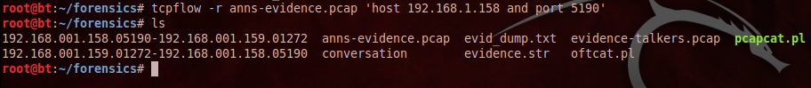
Flow Analysis (con’t)
Export TCP Flow
We can use pcapcat to export the flow in question and try to recover what was transferred in that flow.
Tcpflow can also be used to extract content. Note, the files that tcpflow creates.
Notes:
The filenames provide the source IP and port and the destination IP and port, as well as the direction communication is flowing in the files.
This can also be done in Wireshark.

Slide 39
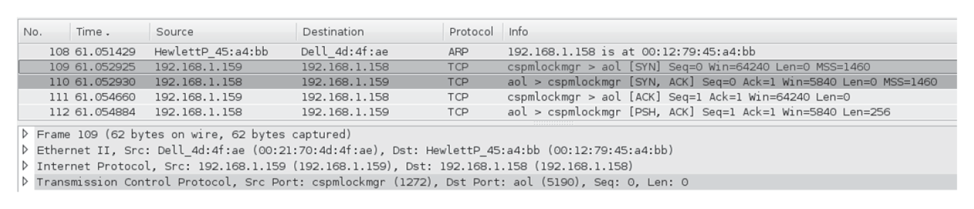
From Network Forensics, by Sherri Davidoff and Jonathan Ham (ISBN: 978-0-13-256471-7) Copyright © 2012 Pearson Education, Inc. All rights reserved.
Figure 4.18 Frame #109 shown in Wireshark. This frame is part of the identified conversation of interest between 192.168.1.158 and 192.168.1.159 on TCP port 5190.

Slide 40
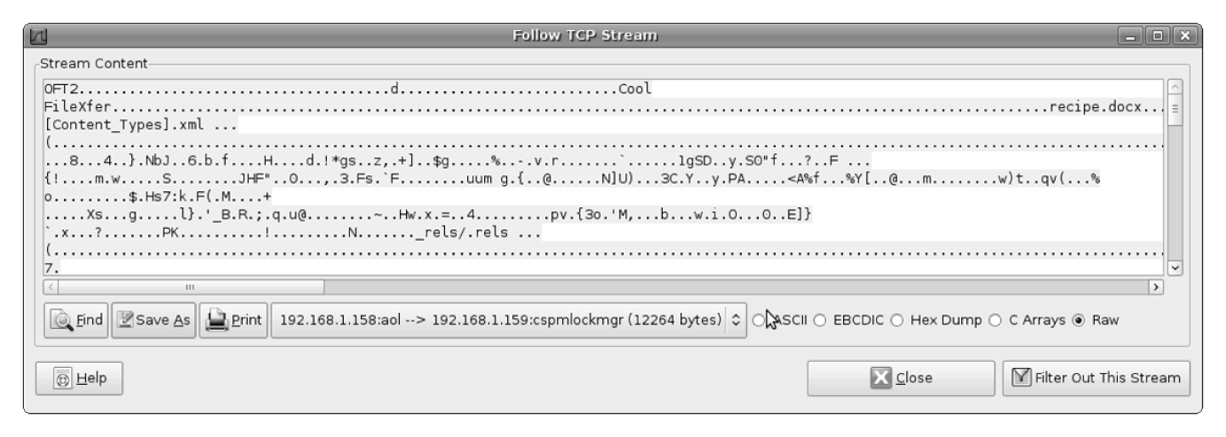
From Network Forensics, by Sherri Davidoff and Jonathan Ham (ISBN: 978-0-13-256471-7) Copyright © 2012 Pearson Education, Inc. All rights reserved.
Figure 4.19 Wireshark’s “Follow TCP Stream” function, used to isolate the TCP stream between 192.168.1.158 and 192.168.1.159 on TCP port 5190. In this screenshot, we have selected one direction of the stream, which appears to contain an OFT2 file transfer of the file “recipe.docx.”

Slide 41
Flow Analysis (con’t)
File and Data Carving
Now that we have saved the stream, we can try to carve out the actual file from the output.
The following figures walk us through the dump file to carve out the data.
Figure 4-20 through 4-26

Slide 42
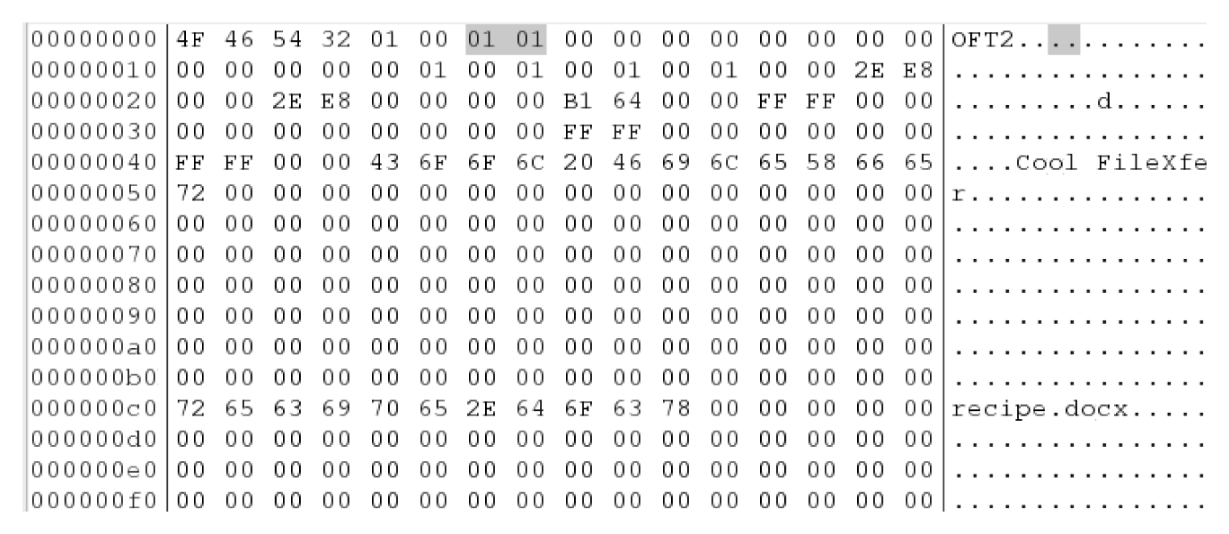
From Network Forensics, by Sherri Davidoff and Jonathan Ham (ISBN: 978-0-13-256471-7) Copyright © 2012 Pearson Education, Inc. All rights reserved.
Figure 4.20 The beginning of our exported flow, internal-stream.dump. Notice the first 4 bytes in the stream are “OFT2,” which mark the beginning of an OFT header. Bytes 6–7 (“Type”) are 0x0101, which indicates that the sender is ready to transfer data.

Slide 43
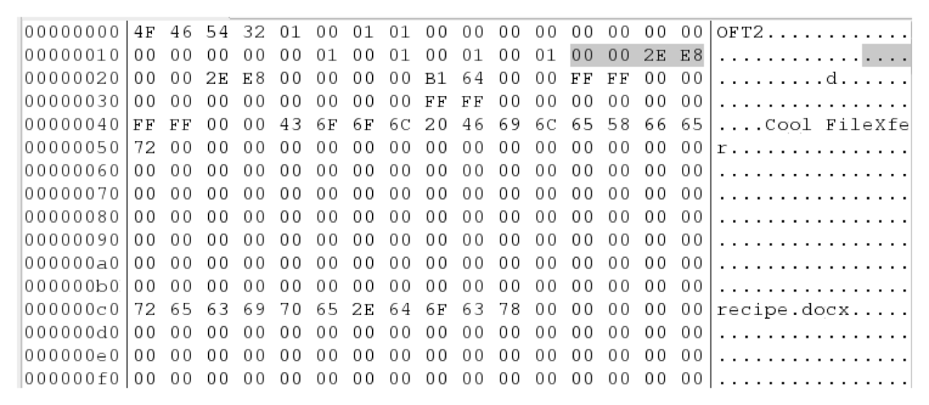
From Network Forensics, by Sherri Davidoff and Jonathan Ham (ISBN: 978-0-13-256471-7) Copyright © 2012 Pearson Education, Inc. All rights reserved.
Figure 4.21 Our exported flow, internal-stream.dump, shown in Bless. Bytes 28–31 represent the “Total Size” of the file that the sender intends to transfer. In this case, the “Total Size” is “0x00002EE8,” or 12,008 bytes in decimal. Further below, we an see the filename “recipe.docx,” which begins at Byte 192 of the OFT header.

Slide 44
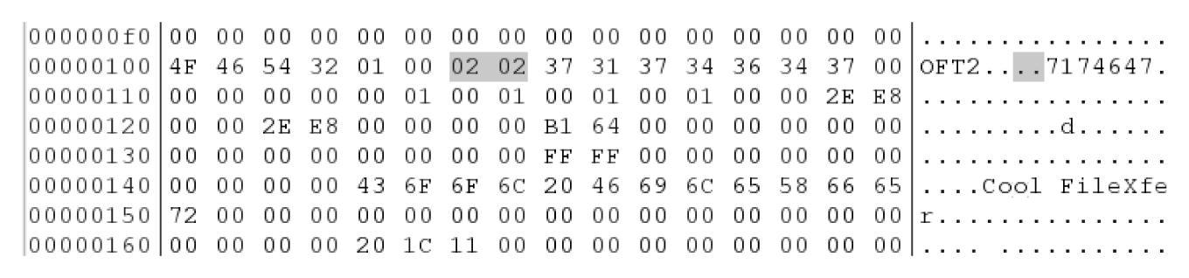
From Network Forensics, by Sherri Davidoff and Jonathan Ham (ISBN: 978-0-13-256471-7) Copyright © 2012 Pearson Education, Inc. All rights reserved.
Figure 4.22 Our exported flow, internal-stream.dump, shown in Bless. Here at Byte 256 (0x100) we see a second OFT header with “Type” 0x0202, or “Acknowledge.” OFT “Acknowledge” packets are sent by the recipient to the sender to indicate that the recipient is ready to receive the file transfer.

Slide 45
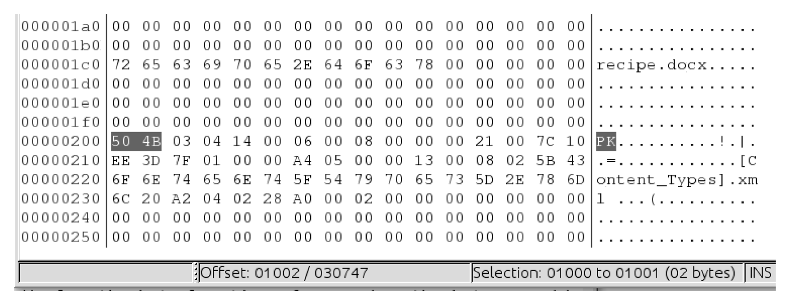
From Network Forensics, by Sherri Davidoff and Jonathan Ham (ISBN: 978-0-13-256471-7) Copyright © 2012 Pearson Education, Inc. All rights reserved.
Figure 4.23 Our exported flow, internal-stream.dump, shown in Bless. The magic number for a .docx file, 0x504B, appears at Bytes 512–513 (0x200–0x201).

Slide 46
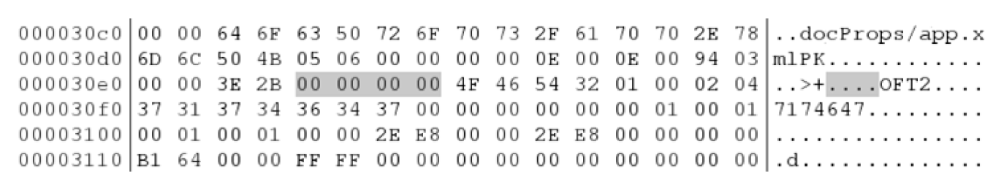
From Network Forensics, by Sherri Davidoff and Jonathan Ham (ISBN: 978-0-13-256471-7) Copyright © 2012 Pearson Education, Inc. All rights reserved.
Figure 4.24 Our exported flow, internal-stream.dump, shown in Bless. The .docx file ends just before Byte 0x30E8. We see that it ends with 4 null bytes, and is immediately followed by an OFT2 “Done” header (Type “0x0204”).

Slide 47
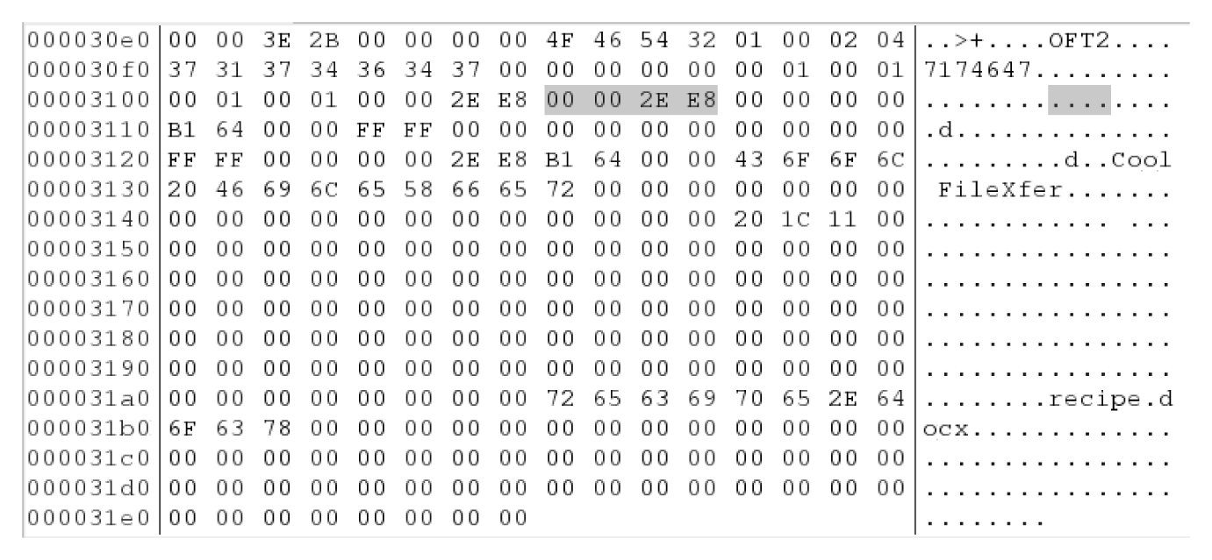
From Network Forensics, by Sherri Davidoff and Jonathan Ham (ISBN: 978-0-13-256471-7) Copyright © 2012 Pearson Education, Inc. All rights reserved.
Figure 4.25 Our exported flow, internal-stream.dump, shown in Bless. The OFT2 “Done” header begins at byte offset 0x30E8. Note the “Size” 0x2EE8 (12,008 bytes), which indicates the amount of data that has already been transferred. This matches the total file size indicated by the sender, which means our file transfer is complete.

Slide 48
Flow Analysis (con’t)
File and Data Carving
The Bless Hex Editor (need to download to Backtrack box, is on classshare) allows us to cut the actual file out of the dump file.
Figure 4-27 shows the contents of the recipe.docx file.
Manually carving out files is tedious and difficult, tcpxtract allows us to extract files from the evidence.pcap capture.

Slide 49
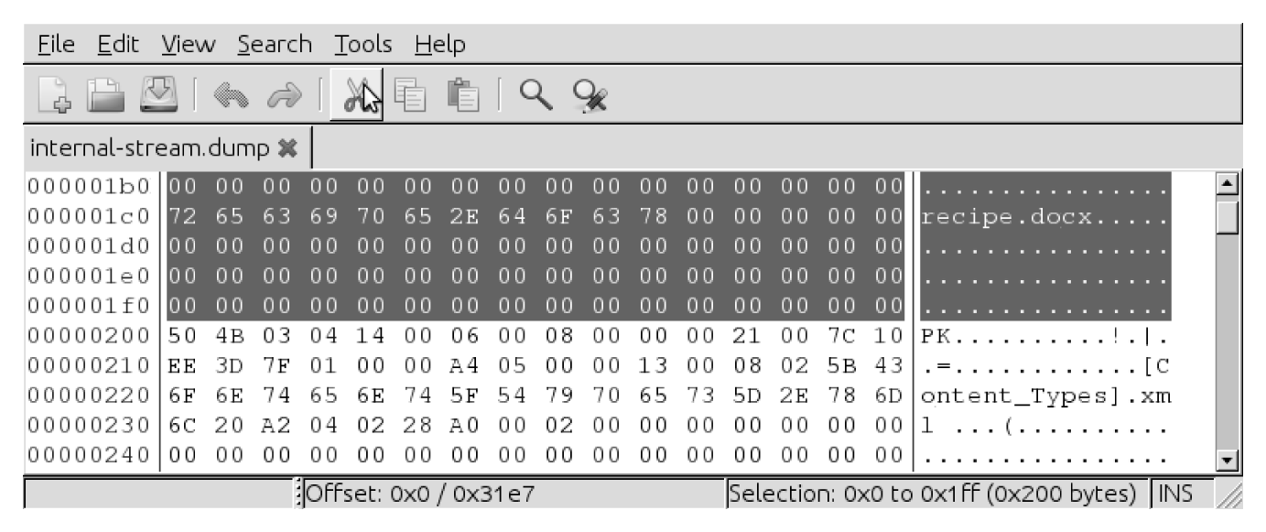
From Network Forensics, by Sherri Davidoff and Jonathan Ham (ISBN: 978-0-13-256471-7) Copyright © 2012 Pearson Education, Inc. All rights reserved.
Figure 4.26 In this screenshot, we are using Bless to snip off the extra data before the transferred .docx file.

Slide 50
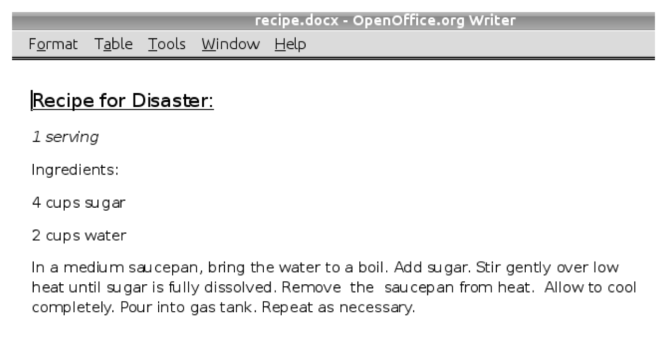
From Network Forensics, by Sherri Davidoff and Jonathan Ham (ISBN: 978-0-13-256471-7) Copyright © 2012 Pearson Education, Inc. All rights reserved.
Figure 4.27 Here is the file we carved out of the OFT transfer, recipe.docx. The contents are shown in OpenOffice.

Slide 51
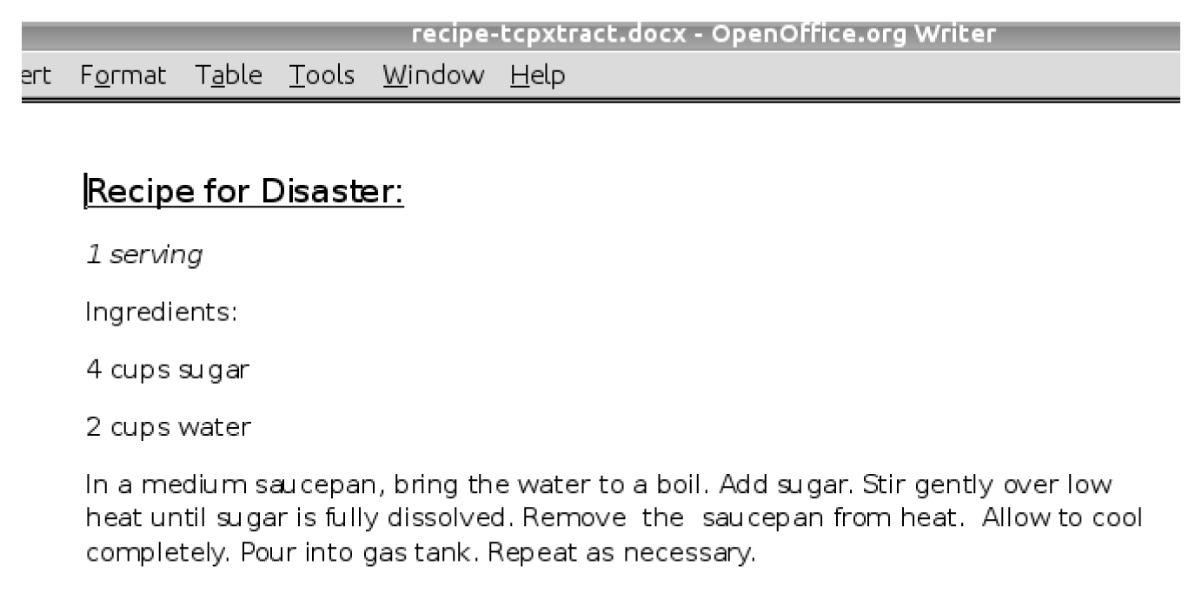
From Network Forensics, by Sherri Davidoff and Jonathan Ham (ISBN: 978-0-13-256471-7) Copyright © 2012 Pearson Education, Inc. All rights reserved.
Figure 4.28 Here is a file we carved out of the OFT transfer using tcpxtract. The contents are shown in OpenOffice. Note that the contents appear to be the same as the file we carved out earlier manually—but as we will see, they are not quite the same.

Slide 52
Flow Analysis (con’t)
File and Data Carving
Figure 4-29 and figure 4-30 compares the manual extraction to the tcpxtract version of the file.
There is a difference between the manual version and the tcpxtract version.
IP header length is 40 bytes, this includes the 20 byte tcp header length. Note in the TCP section of the capture file the Len=0 (this is the length of the data payload for this packet, which is nothing)
Tcpxtract looks for the magic number “0x504B0304” which marks the beginning of a zip file. If this magic number not seen, then it will pad the extracted file.
Trust, but verify what you extract. In this case the manual extraction is the more accurate one.

Slide 53
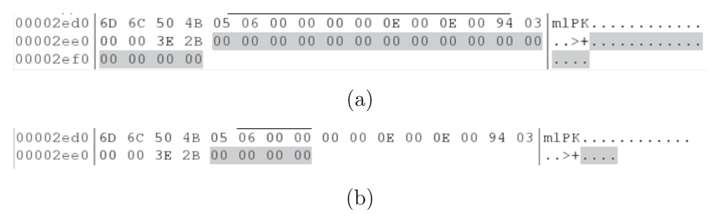
From Network Forensics, by Sherri Davidoff and Jonathan Ham (ISBN: 978-0-13-256471-7) Copyright © 2012 Pearson Education, Inc. All rights reserved.
Figure 4.29 This screenshot shows the ends of the two files that we carved out. The top file (a) was carved by tcpxtract, and the bottom file (b) was carved manually. Notice that the file carved by tcpxtract had 16 nulls at the end, but the manually carved file only had 4.

Slide 54
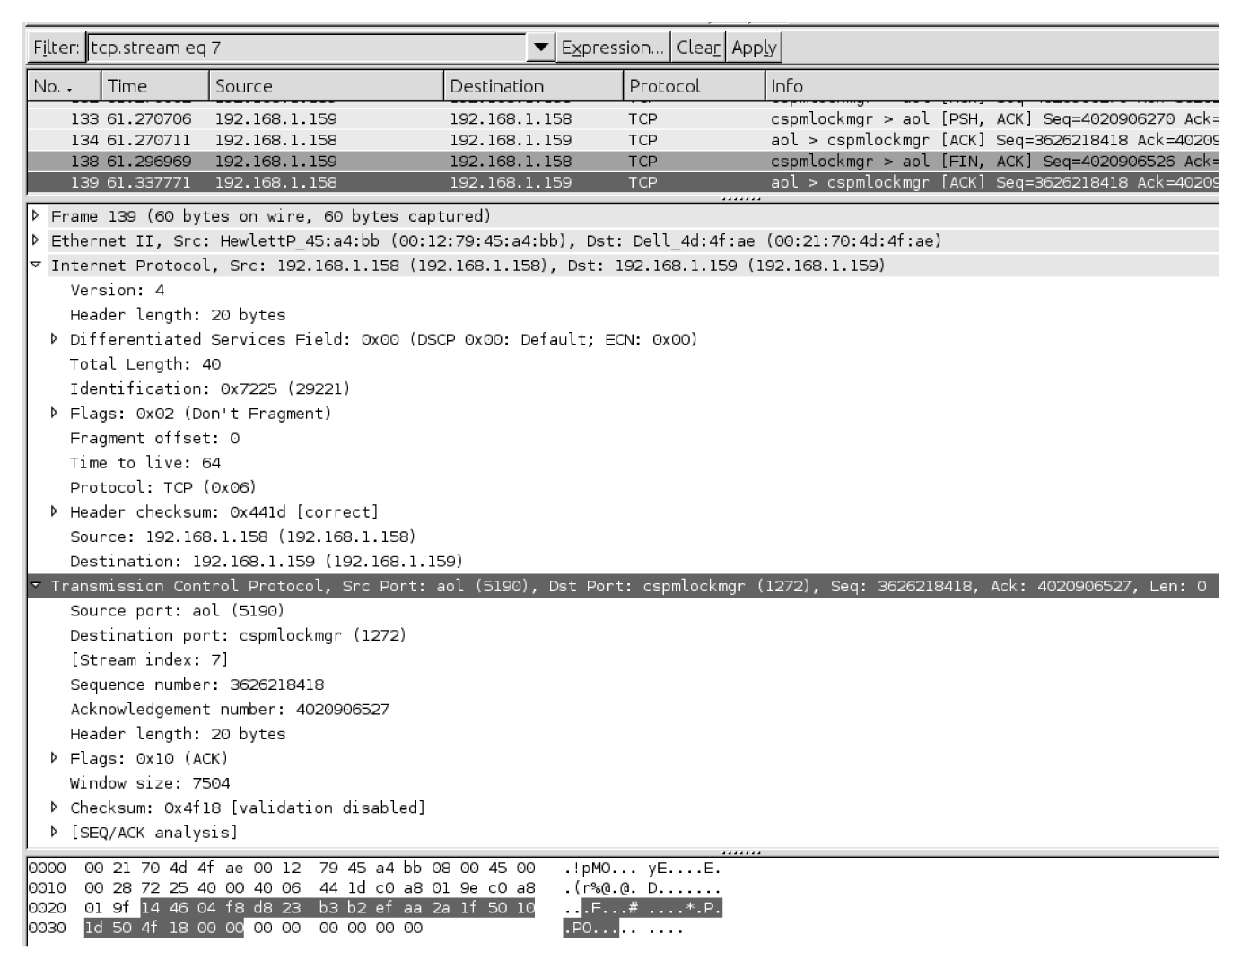
From Network Forensics, by Sherri Davidoff and Jonathan Ham (ISBN: 978-0-13-256471-7) Copyright © 2012 Pearson Education, Inc. All rights reserved.
Figure 4.30 After the end of the file transfer, 192.168.1.158 sent two additional TCP packets to192.168.1.159 (#134 and #139). Neither of these packets contains any data within the TCP payload. Each packet is padded with six nulls at the end by the network card, to reach the minimum size for an Ethernet frame (46 bytes).

Slide 55
Higher-Layer Traffic Analysis
Hypertext Transfer Protocol (HTTP)
Simple Mail Transfer Protocol (SMTP)
Domain Name System (DNS)
Dynamic Host Configuration Protocol (DHCP)

Slide 56
Hypertext Transfer Protocol (HTTP)
Created by Tim Berners-Lee in the 1990’s to enable scientists to share information in a flexible way.
Also created the HTML language to enable the display of information in a browser, he created.
Uses a request/response model to obtain information from servers and delivered to clients.
Also uses the GET and POST methods in communication between client and server.
Methods are defined in RFC 2616
Notes:
RFC 2616 methods:
OPTIONS – obtain information about communicating with the remote server
GET – retrieve the information identified by the URI.
HEAD – retrieve the information identified by the URI, without returning the message-body. Helpful for URI validation and debugging.
POST - send data to the resource specified by the URI for processing.
PUT – upload information to be stored under the specified URI.
DELETE – delete the resource specified by the URI.
TRACE – echo a request message back to the client. Helpful for debugging (can also facilitate cross-site scripting attacks).
CONNECT – reserved “for use with a proxy that can dynamically switch to being a tunnel.”

Slide 57
Hypertext Transfer Protocol (HTTP)
Status codes:
1xx = Informational – request received, continuing process
2xx = Success – action was successfully received, understood, and accepted
3xx = redirection – further action must be taken in order to complete the request
4xx = Client Error – request contains bad syntax or cannot be fulfilled
5xx = Server Error – server failed to fulfill an apparently valid request

Slide 58
Dynamic Host Configuration Protocol (DHCP)
Layer 7 protocol that facilitates assignments of network details (e.g. IP address, gateway, DNS, etc.)
MAC Addresses
First 3 bytes are the manufacturer of the network card (figure 4-31, next slide)
DHCP process
DORA

Slide 59
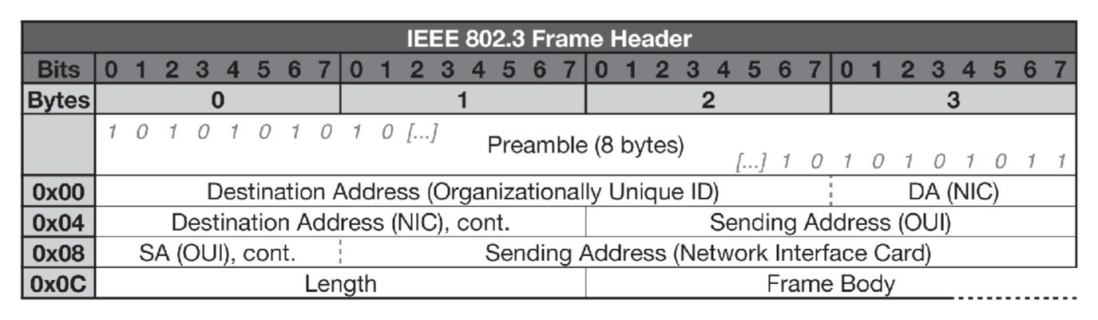
From Network Forensics, by Sherri Davidoff and Jonathan Ham (ISBN: 978-0-13-256471-7) Copyright © 2012 Pearson Education, Inc. All rights reserved.
Figure 4.31 Every network card on an Ethernet network has a 6-byte MAC address, assigned by the manufacturer. Manufacturers have their own 3-byte registered identification number (known as an OUI), which they set as the higher-order 3 bytes of the MAC address.

Slide 60
Simple Mail Transfer Protocol (SMTP)
Basic Use – much like “snail mail”, email goes through multiple stations before arriving at the destination (figure 4-32)
Terminology
Mail User Agent (MUA)
Mail Submission agent (MSA)
Mail Transfer Agent (MTA)
Mail eXchanger (MX)
Mail Delivery Agent (MDA)
Notes:
Mail User Agent (MUA) – end-user’s mail client
Mail Submission agent (MSA) – Handles local mail submission
Mail Transfer Agent (MTA) – Transfers mail between mail servers
Mail eXchanger (MX) – Accepts incoming messages for a domain
Mail Delivery Agent (MDA) – Handles local mail delivery

Slide 61
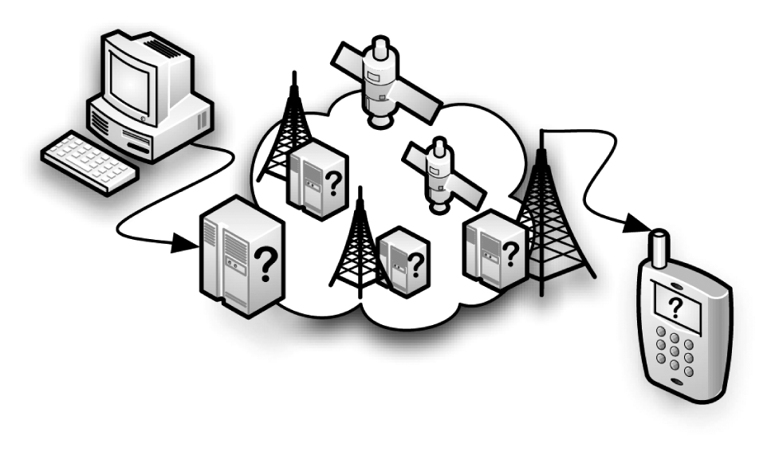
From Network Forensics, by Sherri Davidoff and Jonathan Ham (ISBN: 978-0-13-256471-7) Copyright © 2012 Pearson Education, Inc. All rights reserved.
Figure 4.32 As with snail mail, an email message goes through multiple stations on the way to its destination.

Slide 62
Simple Mail Transfer Protocol (SMTP)
Basic Commands:
HELO – opens the connection
MAIL – specifies the return address
RCPT – specifies the recipient address(es)
DATA – the contents of the message
SMTP Authentication
Not required in the early 1990s

Slide 63
Domain Name System (DNS)
Resolves Domain names to IP addresses
DNS Recursion: DNS server takes initial request and then queries through the hierarchy of domains to resolve the name to an IP address, then caches the answer for future reference.
DNS Queries: can be done simply with the Dig utility

Slide 64
Higher-Layer Analysis Tools
Oftcat – data carving tool used in conjunction with pcapcat or tcpflow to recover files transferred within a data stream and saves them with their correct names, based on OFT metadata.
SMTPdump – use the help for usage
Findsmtpinfo.py – good for reporting SMTP information
NetworkMiner – downloadable from http://networkminer.sourceforge.net/

Slide 65
Higher-Layer Analysis Techniques
Small, specialized tools – can be used to perform specific functions and obtain specific information
For example: tcpflow, oftcat, etc.
Multipurpose Tool
NetworkMiner (figure 4-33)

Slide 66
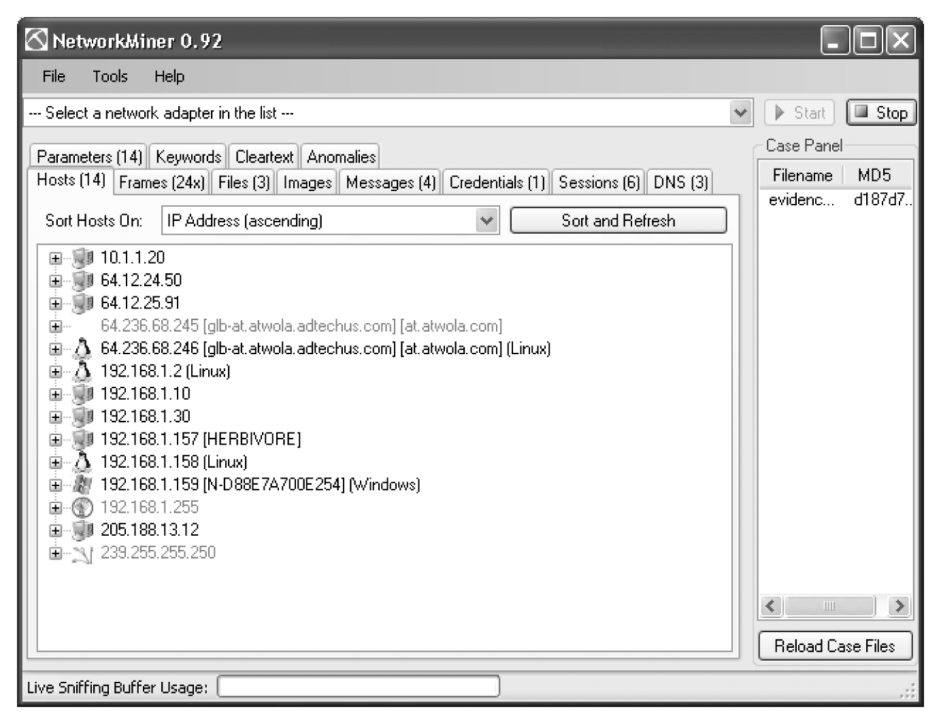
From Network Forensics, by Sherri Davidoff and Jonathan Ham (ISBN: 978-0-13-256471-7) Copyright © 2012 Pearson Education, Inc. All rights reserved.
Figure 4.33 NetworkMiner with the “Ann’s Bad AIM” evidence01.pcap loaded.

Slide 67
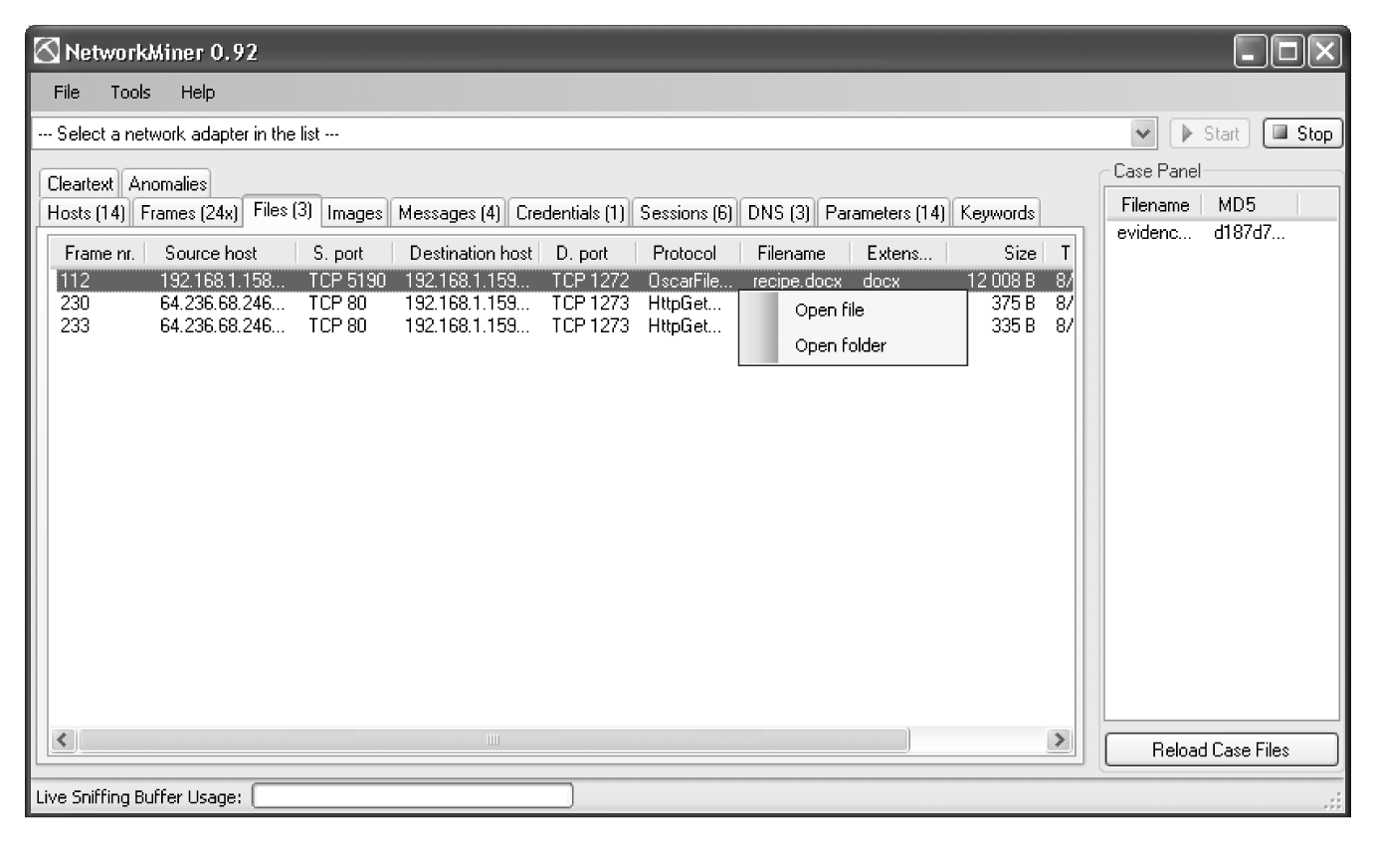
From Network Forensics, by Sherri Davidoff and Jonathan Ham (ISBN: 978-0-13-256471-7) Copyright © 2012 Pearson Education, Inc. All rights reserved.
Figure 4.34 NetworkMiner has already extracted recipe.docx.

